Slide 1
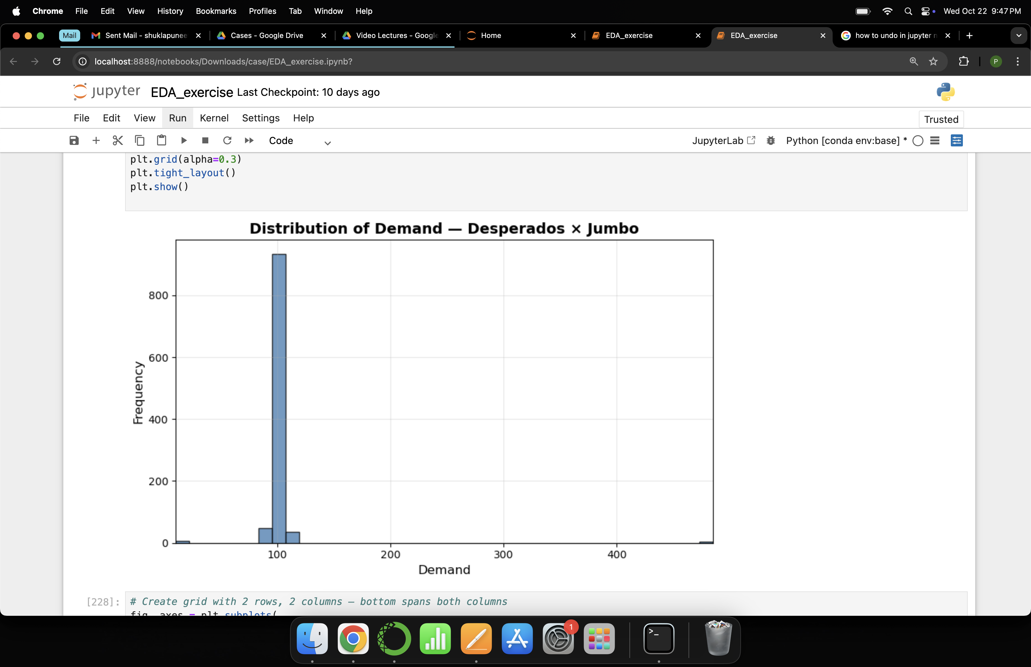
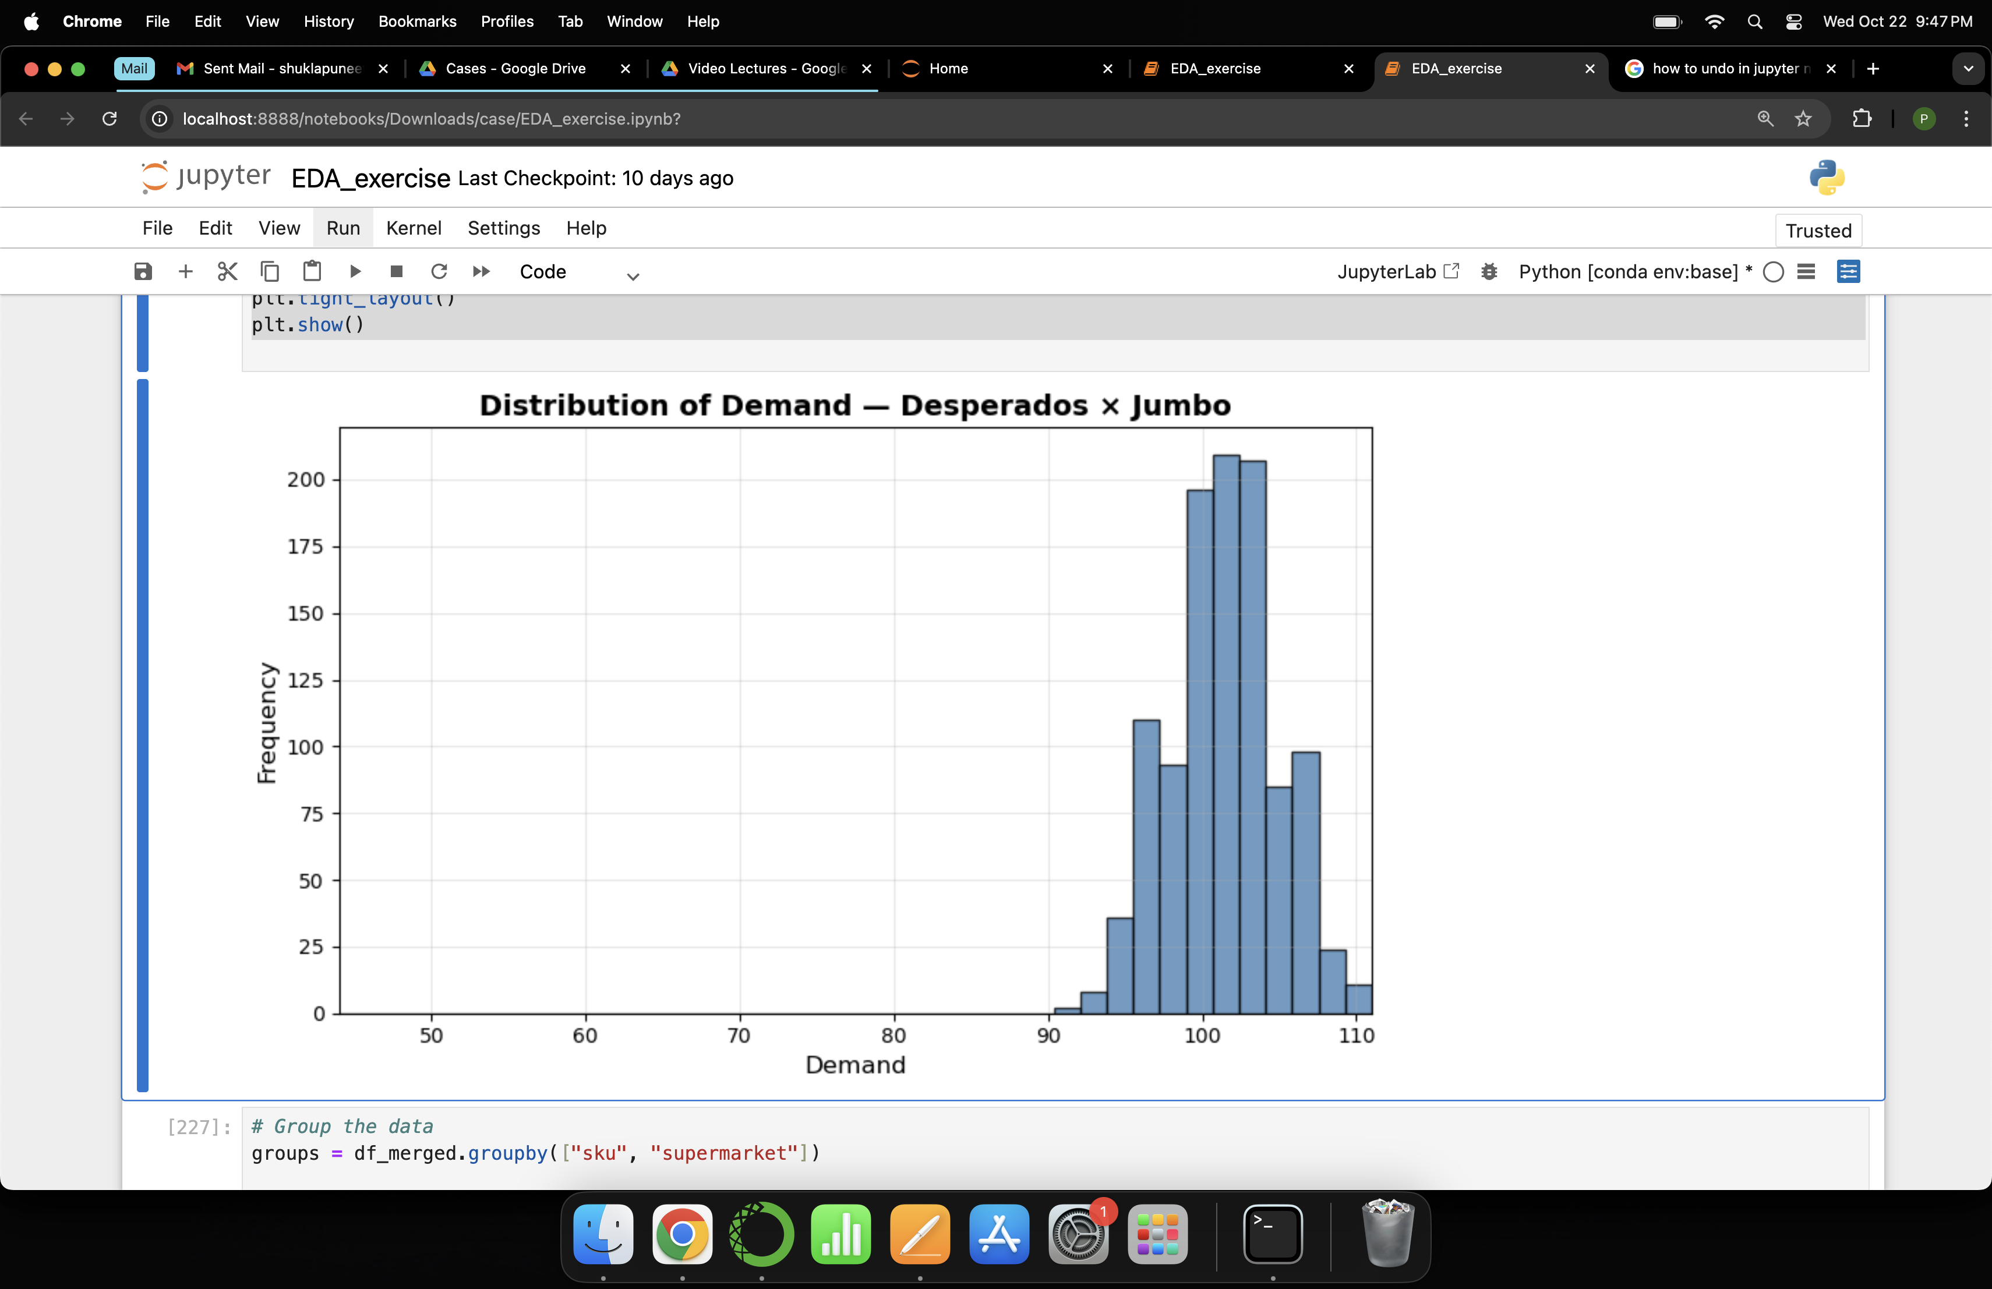
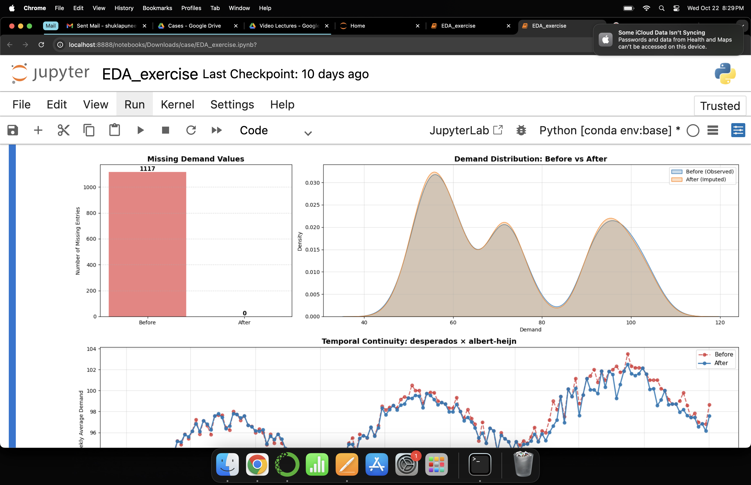
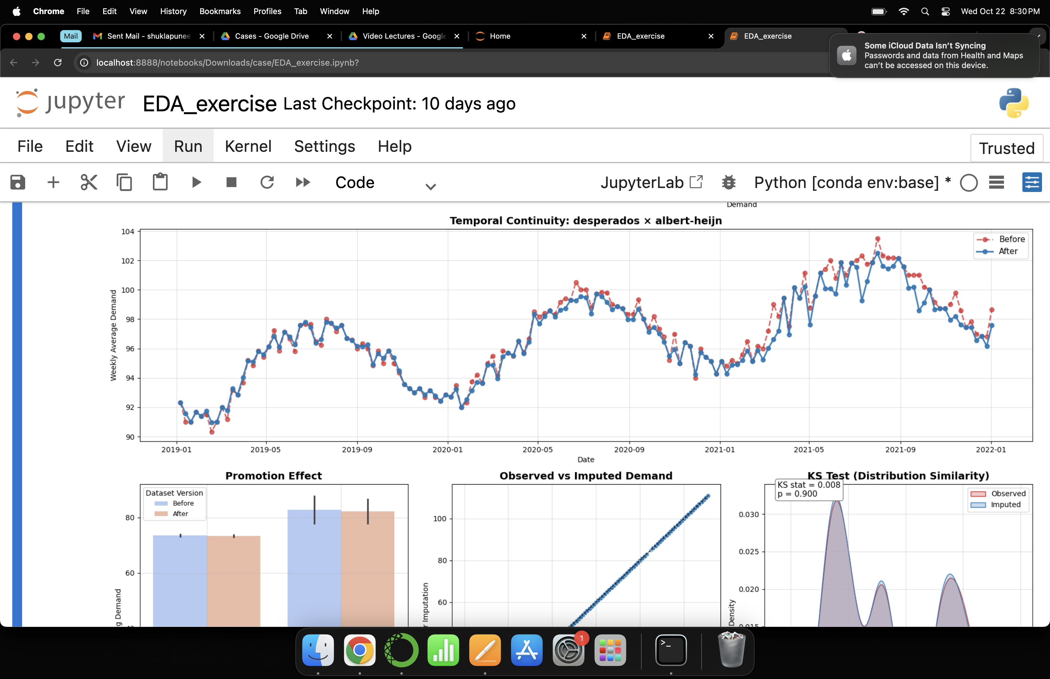
Handling extreme values
Demand forecasting model
Before
After
Model | Test |  |  |  | CV
 | Adj R² | RMSE | MAE | sMAPE | sMAPE
ElasticNet | 0.9961 | 7.63 | 5.91 | 1.16 | 19.26
Lasso | 0.9959 | 7.81 | 5.88 | 1.15 | 23.50
Ridge | 0.9958 | 7.98 | 6.20 | 1.21 | 20.42
CatBoost | 0.9932 | 10.22 | 8.31 | 1.62 | 24.69
XGBoost | 0.9921 | 11.01 | 8.64 | 1.67 | 25.02
LightGBM | 0.9910 | 11.72 | 9.64 | 1.88 | 30.70
RandomForest | 0.9869 | 14.13 | 12.18 | 2.44 | 32.65
Fine-tuned multiple regularized and ensemble models to achieve the most accurate and stable demand forecasts.
Elastic-Net outperforms ensemble models on all test-set metrics and generalizes better (lowest CV sMAPE).
Elastic-Net explains over 99.6% of variance in weekly demand.
Elastic-Net outperforming ensemble models suggests there is little non-linearity; engineered features (lags, roll, fourier) linearize the temporal structure.
Note: The relatively higher CV sMAPE arises because it was computed on scaled target values, while Test sMAPE reflects performance on the original demand values.
800
200
600
150
400
100
200
50
100
200
300
400
50
60
70
80
90
100
110
Outliers removed using Inter-Quartile Range (IQR).
Achieved smooth Gaussian-like distributions for SKU x Supermarket that align with model assumptions.
Improved model generalization caused by rare, extreme spikes or data entry errors.
Handling missing values
Explanatory modelling for interpretation
Missingness
Distribution Density
Coefficient | Interpretation*
Intercept (518.3) | Represents the expected weekly demand for Desperados at Albert-Heijn when all other variables (momentum, volatility, seasonality) are at average levels.
Momentum (+6.86) | Each additional unit sold yesterday increases the weekly demand by ~6.9 units — suggesting strong momentum and repeat purchase behaviour across brands.
Seasonality (+11.79) | There is a 12-unit swing in weekly demand linked to long-term annual seasonality, e.g. higher sales in summer months and dips in winter.
Volatility (−3.61) | Higher variability in past 4-week sales tends to lower future demand, suggesting demand consistency drives sales.
Heineken 0.0 (−4.68) | Heineken 0.0 baseline demand is ~4.7 units lower than Desperados (Albert-Heijn).
Heineken Regular (−2.12) | Heineken Regular baseline demand is ~2.1 units lower than Desperados (Albert-Heijn).
Heineken 0.0 × Dirk (+3.79) | Heineken 0.0 performs 3.8 units higher at Dirk than expected — stronger consumer affinity at this retailer.
Adj R² = 0.983: Model captures almost all systematic variation in demand.
F-stat = 87,230: High overall explanatory power.
p-values < 0.001: Each predictor improves model fit.
Condition Number = 101: Low multicollinearity, coefficients are stable and interpretable.
Durbin-Watson = 1.48: Minor temporal dependence, expected in time series, not a major issue.
1,117
missing entries
density
0
40
80
100
120
Before
After
60
demand
Temporal Consistency
date
avg. weekly demand
2019-01
2019-05
2019-09
2020-01
2020-05
2020-09
2021-01
2021-05
2021-09
2022-01
Before (Observed)
After (Imputed)
Imputed missing values via regularized regression (i.e. Lasso Regression).
R² on test set was 0.977, indicating strong model fit.
Strong linear alignment between observed and imputed values, indicating key relationships preserved post-imputation.
Relative lifts during promotion periods remain consistent.
The Kolmogorov-Smirnov (KS) statistical test shows no significant difference between original and imputed distributions.
* forecasting weekly demand 8 weeks in advance

